Slide 1

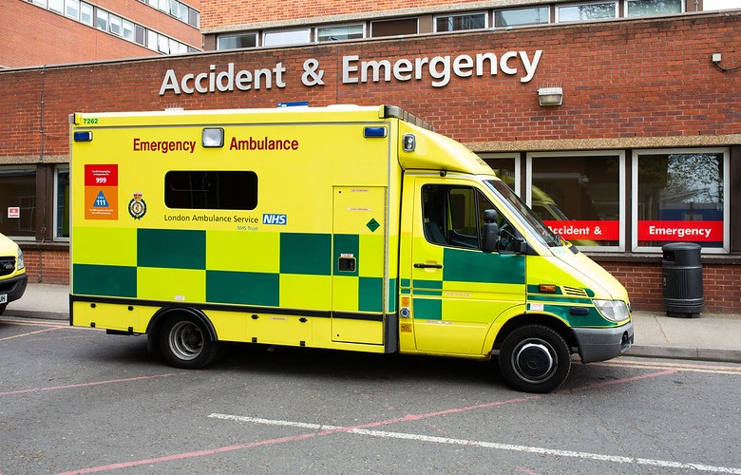
A&E Dataset Exploration: Unveiling Critical Patterns
Dolapo Adebo

Slide 2


Slide 5


Slide 6
QUESTIONS?

